Slide 1
JOINS

Slide 2
JOIN
INNER
CROSS
OUTER
LEFT OUTER
RIGHT OUTER

Slide 3
JOIN
A JOIN clause is used to combine rows from two or more tables, based on a related column between them.
Syntax:
SELECT column-names
FROM table-name1 JOIN table-name2
ON column-name1 = column-name2
WHERE condition

Slide 4
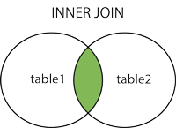
Inner Join
The INNER JOIN keyword selects records that have matching values in both tables.
An SQL INNER JOIN is same as JOIN clause, combining rows from two or more tables.

Slide 5
Syntax:
SELECT column_name(s) FROM table1 INNER JOIN table2 ON table1.column_name = table2.column_name;

Slide 6
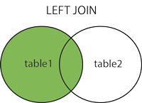
Left Join
The LEFT JOIN keyword returns all records from the left table (table1), and the matched records from the right table (table2).
The result is NULL from the right side, if there is no match.

Slide 7
Syntax:
SELECT column_name(s) FROM table1 LEFT JOIN table2 ON table1.column_name = table2.column_name;

Slide 8
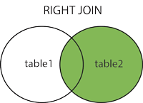
Right Join
The RIGHT JOIN keyword returns all records from the right table (table2), and the matched records from the left table (table1).
The result is NULL from the left side, when there is no match.

Slide 9
Syntax:
SELECT column_name(s) FROM table1 RIGHT JOIN table2 ON table1.column_name = table2.column_name;

Slide 10
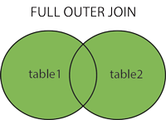
Full outer Join
The FULL OUTER JOIN keyword return all records when there is a match in either left (table1) or right (table2) table records.
FULL OUTER JOIN can potentially return very large result-sets.
FULL OUTER JOIN and FULL JOIN are the same.

Slide 11
Syntax:
SELECT column_name(s) FROM table1 FULL OUTER JOIN table2 ON table1.column_name = table2.column_name WHERE condition;

Slide 12
Self Join
A self JOIN is a regular join, but the table is joined with itself.
Syntax:
SELECT column_name(s) FROM table1 T1, table1 T2 WHERE condition;

Slide 13


